Slide 1
Customer Churn Prediction
By, Emma, Jason and Sam.

Slide 2
Overview of Project
Predicting customer churn, or the likelihood that a customer will stop doing business with a company, is an important task for any business. By predicting churn, companies can take proactive steps to try to retain their customers and prevent them from leaving.
This can help to reduce the costs associated with acquiring new customers and can also help to maintain and grow the company's revenue.

Slide 3
Overview of Project
There are a number of techniques that can be used to predict customer churn, including machine learning algorithms ;
Logistic regression
Naive Bayes Classifier
Tree-based algorithms
Random Forest
To increase efficiency, you can use advanced algorithms;
XGBoost
LightGBM
CatBoost

Slide 4
Our Data
This code reads in a CSV file called "Churn_Modelling.csv"
DataFrame has 10000 rows and 14 columns, as indicated by the output. Each row represents a customer and the columns contain various attributes or features of the customer, such as their credit score and estimated salary.
The code then uses the dtypes attribute to display the data type associated with each column. This is useful for identifying which columns contain categorical variables.
Categorical variables identified:
Surname
Geography
Gender

Slide 5
Our Data
We then perform one-hot encoding on the categorical variables
One-hot encoding represents categorical variables as numerical data that is suitable for machine learning algorithms by creating a binary column for each unique category.
two new variables are defined: y, which is the target variable (the "Exited" column), and X, which is the feature set (all the columns in attrition_df except for "Exited").

Slide 6
Training and Testing Sets
In this step of the project, we prepared the data for machine learning by splitting it into training and testing sets, and standardizing the features.
We used the train_test_split function to split the feature set (X) and the target variable (y) into training and testing datasets. We also used the StandardScaler class to standardize the features.
Standardization scales the data so that it has a mean of 0 and a standard deviation of 1. We stored the resulting datasets in variables called X_train_scaled, X_test_scaled, y_train, and y_test. These datasets will be used to train and test a machine learning model in the next steps.

Slide 7
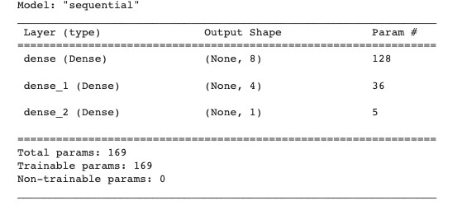
Creating a Deep Neural Network Model
This code is creating a deep neural network model with two hidden layers using TensorFlow's Sequential model class.
The number of input features is determined by counting the columns in the training set.
The number of hidden nodes in the hidden layers are calculated using the mean of the number of input features and the number of output neurons, and the floor division operator (//). The model is then displayed using the summary method.

Slide 8
Compiling the Modal
We compile the Sequential model using the compile method and specify the binary_crossentropy loss function, the adam optimizer, and the accuracy metric.
The loss function is used to measure how well the model is able to predict the target variable. In this case, the binary_crossentropy loss function is used because the target variable is a binary value (0 or 1).
The optimizer is used to adjust the model's weights and biases to minimize the loss function. In this case, the Adam optimizer is used. The metrics are used to evaluate the model's performance.
In this case, the accuracy metric is used, which is the percentage of correct predictions made by the model.

Slide 9
Compiling the modal
We compile the neural network model using the binary_crossentropy loss function, the Adam optimizer, and the accuracy metric. Then, we use the fit method of the model to train it using 100 epochs and the training data. The fit method returns a history object that contains information about the training process, such as the loss and accuracy for each epoch.

Slide 10
Evaluating the model
The evaluate method is used to calculate the loss and accuracy metrics of the model using the test data. The loss is a measure of how well the model is able to predict the target variable. In this case, the loss function used is binary cross-entropy, The accuracy metric is a measure of how many of the predictions made by the model are correct.
The results of evaluating the model on the test data indicate that the model has an accuracy of 85.2%. This means that the model is able to correctly predict the outcome of the target variable (employee attrition) for 85.2% of the observations in the test set.

Slide 11
Logistic Regression Model using training data
We imported the LogisticRegression module from the sklearn library and instantiated a Logistic Regression model using the LogisticRegression class. We set the solver parameter to 'lbfgs' and the random_state parameter to 1. We then fit the model to the training data using the fit method of the LogisticRegression class, passing in the training data and the target variable.
Finally, we used the testing data to make predictions using the predict method and stored the predictions in a variable called "predictions".

Slide 12
Calculate accuracy score, Generate a confusion matrix and print the classification report
The results show that the model has an accuracy of 0.5789, with a precision of 0.82 for predicting when an employee will leave and a precision of 0.58 for predicting when an employee will stay.
The model also has a recall of 0.96 for predicting when an employee will leave and a recall of 0.19 for predicting when an employee will stay.
The f1-score for predicting when an employee will leave is 0.89 and the f1-score for predicting when an employee will stay is 0.29.
The support for predicting when an employee will leave is 1991 and the support for predicting when an employee will stay is 509.

Slide 13

Using the RandomOverSampler to resample the data
We used the RandomOverSampler module from the imbalanced-learn library to resample the data and balance the labels. We instantiated the random oversampler model, set the random_state parameter to 1, and fit the original training data to the model. We then counted the distinct values of the resampled labels data and confirmed that the labels now have an equal number of data points.

Slide 14
Using the LogisticRegression classifier and the resampled data to fit the model.
First, we instantiated the Logistic Regression model and set a random_state parameter of 1. Then, we fit the model using the resampled training data and made a prediction using the testing data. The resulting predictions were stored in a variable called resampled_predictions.

Slide 15
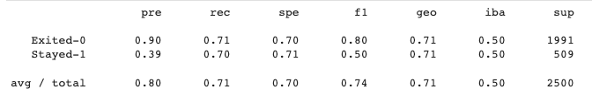
Calculate accuracy score, Generate a confusion matrix and print the classification report
We used the RandomOverSampler module from the imbalanced-learn library to resample the training data in order to balance the label classes. We then instantiated a Logistic Regression model and fitted it to the resampled data using the fit method. We made predictions on the testing data using the predict method.
To evaluate the model's performance, we calculated the balanced accuracy score, generated a confusion matrix, and printed the classification report. The results showed that the model had a balanced accuracy score of 0.71 and an F1 score of 0.74.

Slide 16
Modeling using Random Forest
Modeled using Random Forest classifier with 500 estimators
Trained model on X_train_scaled and y_train data
Made predictions on X_test_scaled data

Slide 17
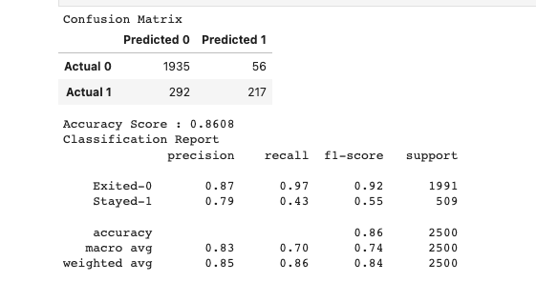
Modeling using Random Forest
Confusion matrix showed 1935 predicted "Exited-0" and 217 predicted "Stayed-1" correctly, and 56 and 292 predicted incorrectly, respectively
Accuracy score of 0.8608
Classification report showed precision, recall, and f1-score for both "Exited-0" and "Stayed-1" classes

Slide 18
Modelling using K-Nearest Neighbors
We trained the KNN model using 3 neighbors and the training data
We made predictions on the test data using the trained model
The model's performance was evaluated using a confusion matrix and a classification report
The model had an accuracy of 81% and a macro average f1-score of 65%

Slide 19
Modelling using XGBoost
Used XGBoost to model customer churn data
Trained model with training data
Made predictions using test data
Evaluated model performance with confusion matrix and classification report
Model had 85% accuracy with 85% precision for predicting customer churn

